Slide 1
R-TREE
The supervision of Professor: Hussam Hussam Abd AlHalim
Student work: Akram Assi.
Hamza Shakshir

Slide 2
Overview
Introduction.
Concept R-tree .
Spatial Data and Spatial Database.
Spatial Query and R-Tree Index Structure.
Insert and Insert Algorithms.
R-Tree – Splitting , Delete and search.
R-tree Variations.
Application.
Size of R-Tree.
References.

Slide 3
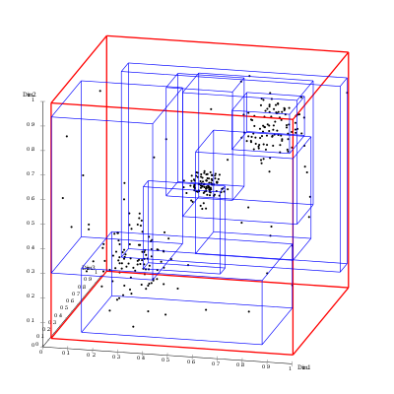
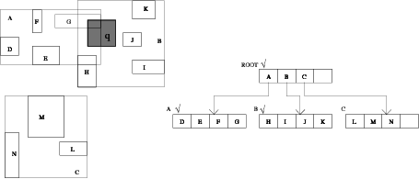
R-tree
tree data structures used for indexing spatial data (multi-dimensional information) such as geographical coordinates, rectangles or polygons.
3D
2D

Slide 4
Concept R-tree
data structure is to group nearby objects and represent them with their minimum bounding rectangle in the next higher level of the tree; the "R" in R-tree is for rectangle
Or, according to some references minimum bounding box "R" in R-tree is for Regine
R1
R4
irregular We can group clusters of data points into “boxes”, called Minimum Bounding Rectangles (MBRs).
R2
R5
R3
R6
R9
R7
R8

Slide 5
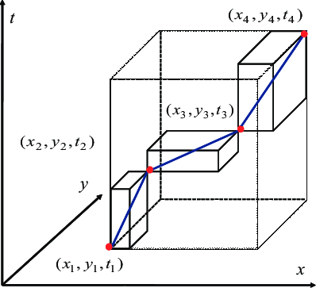
R7 R8 R9
Concept R-tree
…these nested MBRs are organized as a tree (called a spatial access tree or a multidimensional tree).
R10
R11
R10 R11 R12
R1 R2 R3
R4 R5 R6
R12
Data nodes containing points
3d R-TREE

Slide 6
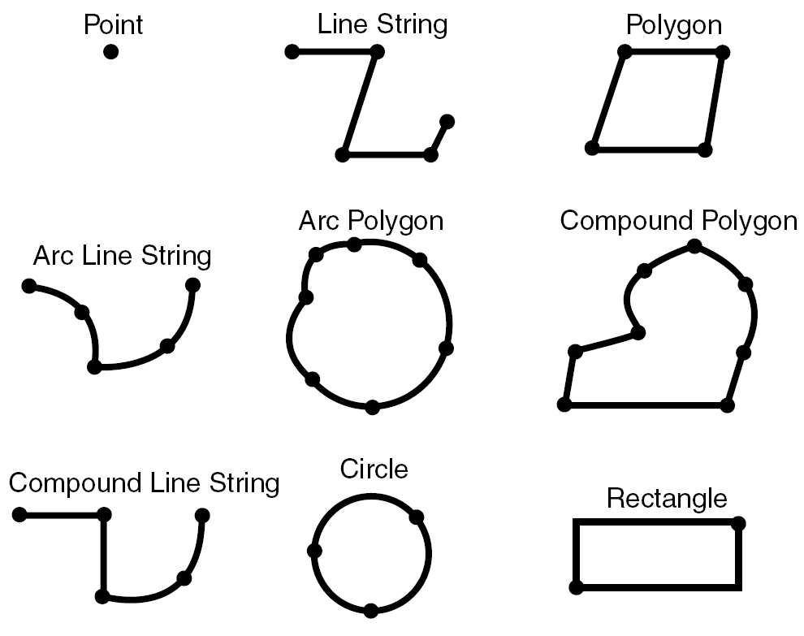
Spatial data
Data which describes either location or shape
GEOMETRY: Spatial object with coordinates expressed as (x,y) pairs, defined in the Cartesian plane. All calculations use Cartesian coordinates.
All geometries may have 2-4D coordinates
Polygons can have holes
Besides, there also exist aggregates, in which geometries of the same type or of mixed type can be contained, e.g.:
MultiPoint
MultiPolygon
MultiGeometry

Slide 7
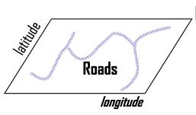
Spatial data
GEOGRAPHY: Spatial object defined as on the surface of a perfect sphere, or a spatial object in the WGS84 coordinate system. Coordinates are expressed in longitude/latitude angular values, measured in degrees. All calculations are in meters. For perfect sphere calculations, the sphere has a radius of 6371 kilometers, which approximates the shape of the earth.
hydrology
The maximum size of a GEOMETRY or GEOGRAPHY data type is 10,000,000 bytes (10 MB). You cannot use either data type as a table's primary key
topography

Slide 8
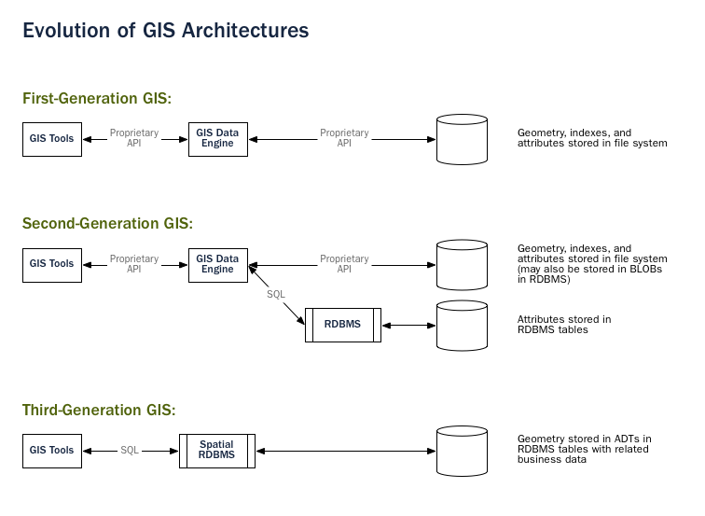
Spatial Database
Example Spatial DBMS
PostgreSQL (POSTGIS)
oracle spatial
SQLserver (2008 or above)

Slide 9
Application
Geographical Information Systems (GIS)
Create geographic data.
Manage it in a database.
Analyze and find patterns.
Visualize it on a map.
Computer-Aided Design/Manufacturing (CAD/CAM)
Autocad 3dmax,blender (CAD)
CNC (CAM)
Multimedia Databases
storing and manipulating characteristics of MM objects.
Images, video, text, etc. stored
retrieved by content

Slide 10
Spatial Query
SFSQL
The Simple Features for SQL (SFSQL) specification from the OGC defines the types and functions that make up a standard spatial database.
Standard Insert, Search and Delete Queries
Spatial Range Queries
Find all Gas stations within 2 km of downtown
Find all employees with salaries between $50,000 and $60,000 and ages between 40 and 50
Nearest Neighbor Queries
Find the closest Mosque to Najah University
Spatial Join Queries
Find all neighborhoods that are within 5 km of a university
Geometry Set Operations
Equal(), Disjoint(), Intersect(), Touch(), Cross(), Within(), Contains(), Overlap(), Distance(), Intersection(), Union(), Difference() and more...

Slide 11
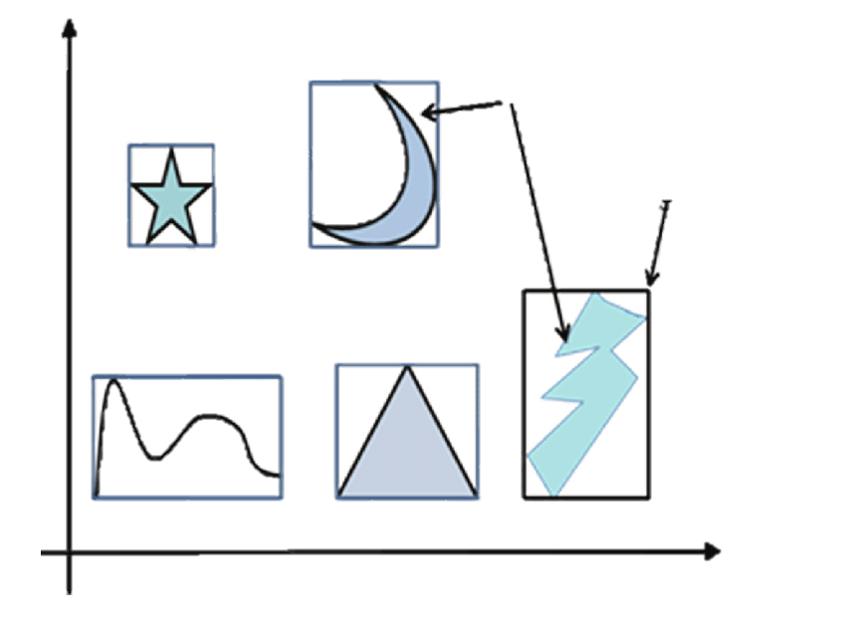
Minimum Bounding Rectangle (MBR)
Approximate each region with a simple shape: usually Minimum Bounding Rectangle (MBR) = [(x1, y1), (x2, y2)]
Y
OBJECT
Minimum Bounding Rectangle (MBR)
(X₂,Y₂)
Rectangle:
coordinate of the lower left corner
coordinate of the upper right corner
(X₁,Y₁)
X

Slide 12
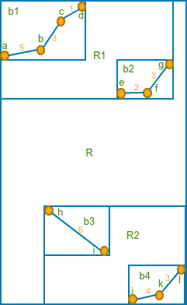
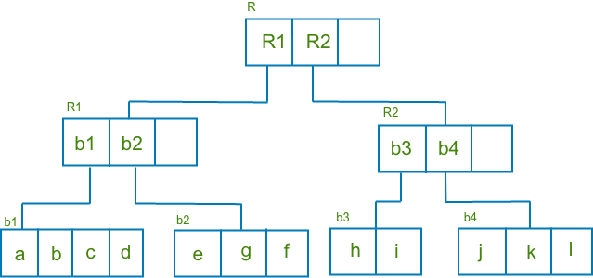
R-Tree Index Structure
The hierarchical structure of an R-tree index is similar to that of a B-tree index, although the data stored in the index is quite different.
Nodes: Each node of the R-tree corresponds to the minimum bounding d-dimensional rectangles (MBR) that bounds its children.
Leaves: The leaves of the tree contain pointers to the database
objects instead of pointers to children nodes.

Slide 13
R-Tree Index Structure
Non-leaf nodes contain entries of the form:
(I(MBR), child-pointer)
Child-pointer is the address of a lower node in the R-Tree.
I covers all rectangles in the lower node’s entries(MBR).
R
x-low, y-low
x-high, y-high
:
child-pointer
...
R1
R2
...
...
b1
b2
:
a
b
c

Slide 14
R-Tree Index Structure
Leaf nodes contain index records:
(I, tuple-identifier)
tuple-identifier is RID(Record ID)
I is an n-dimensional rectangle that bounds the indexed spatial object
I = (I0, I1, …, In-1) where n is the number of dimensions.
R1
R1
R2
...
...
b1
[(50,40),(70,20),RID)]
...
b3
[(50,160),(70,140),rid]
...
MBR
a,b,……

Slide 15
R-Tree Index Structure

Slide 16
R-Tree properties
R-tree has the following properties:
Every leaf node contains between m and M index records. Root node is the exception.
For each index record (I, tuple-identifier) in a leaf node, I is the smallest rectangle that spatially contains the n dimensional data object represented in the indicated tuple.
Every non-leaf node has between m and M children. Root node is the exception.
For each entry (I, child-pointer) in a non-leaf node, I is the smallest rectangle that spatially contains the rectangles in the child node.
The root node has at least two children unless it is a leaf.
All leaves appear on the same level.
Height of a tree = Ceiling(log_{m}N)-1.
Maximum Node in R-TREE (N/M)+{N/M²)+1
Worst case utilization for all nodes except the root is m/M.
M = Maximum number of entries in a node.
m <= M/2
N = Number of records

Slide 17
insert
To insert a data item:
Find a leaf to store it, and add it to the leaf
Handle overflows by splits
Adjust bounding boxes starting from the leaf upwards

Slide 18
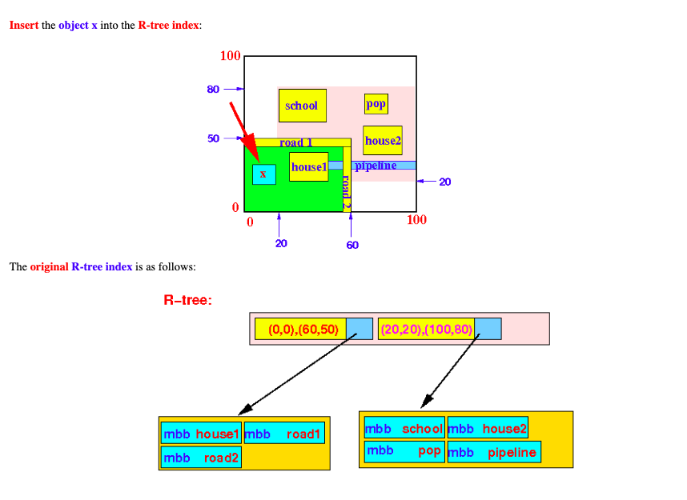
Insert Algorithm in R-tree - Example 1 (easy case)

Slide 19
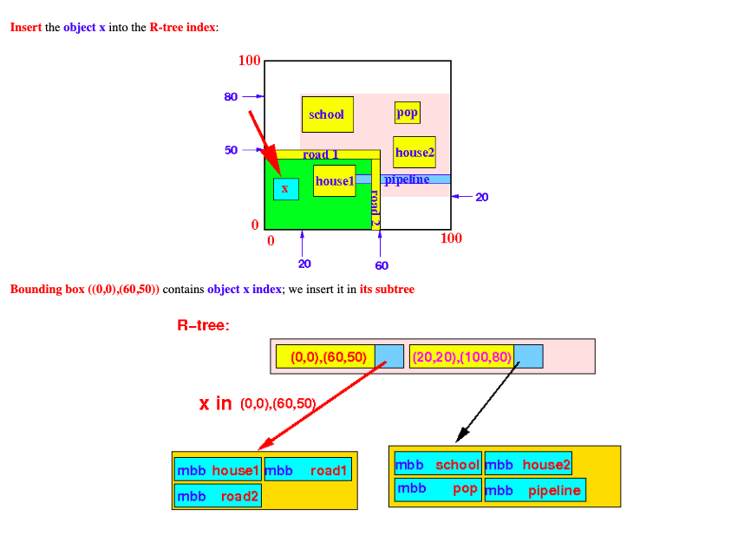
Insert Algorithm in R-tree - Example 1 (easy case)

Slide 20
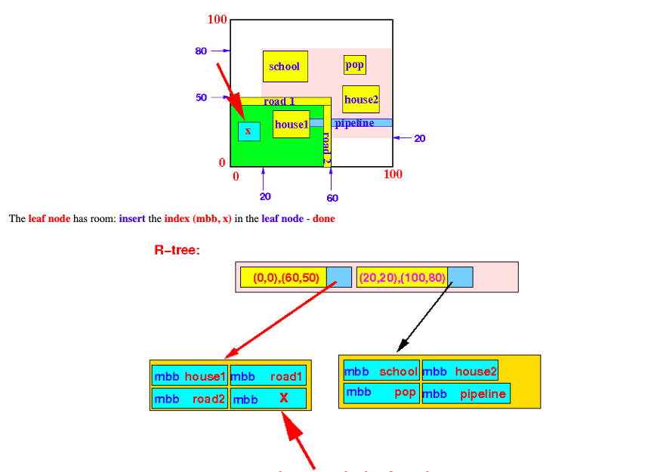
Insert Algorithm in R-tree - Example 1 (easy case)

Slide 21
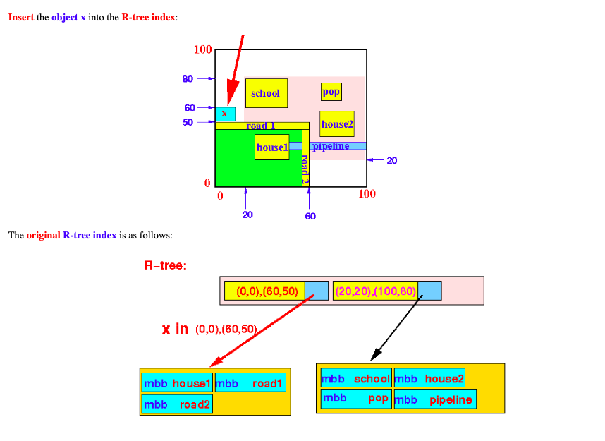
Insert Algorithm in R-tree - Example 2 (enlarge BB)

Slide 22
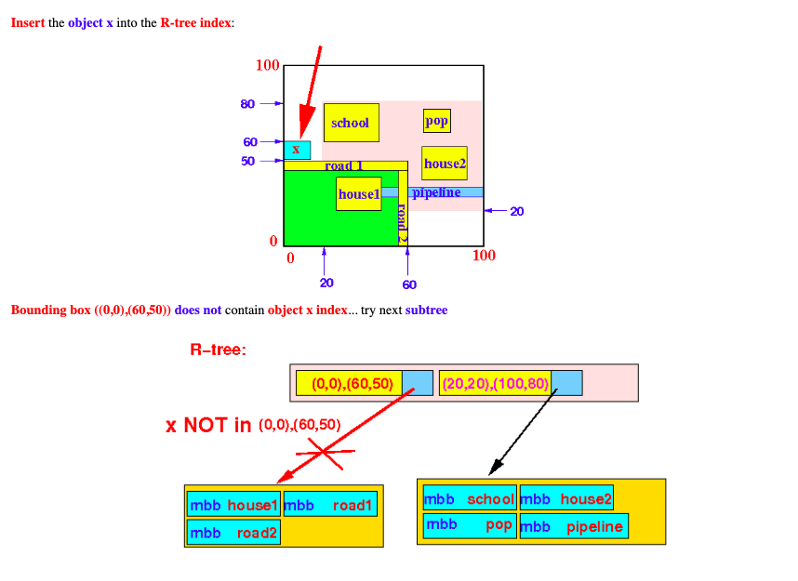
Insert Algorithm in R-tree - Example 2 (enlarge BB)

Slide 23
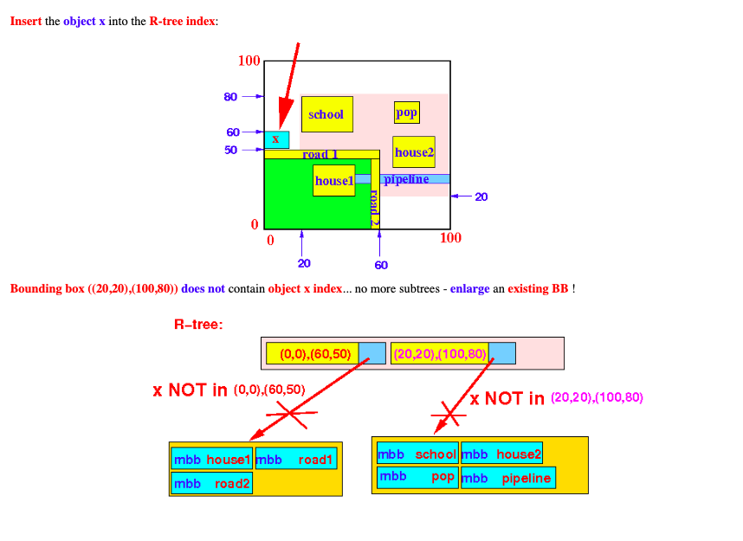
Insert Algorithm in R-tree - Example 2 (enlarge BB)

Slide 24
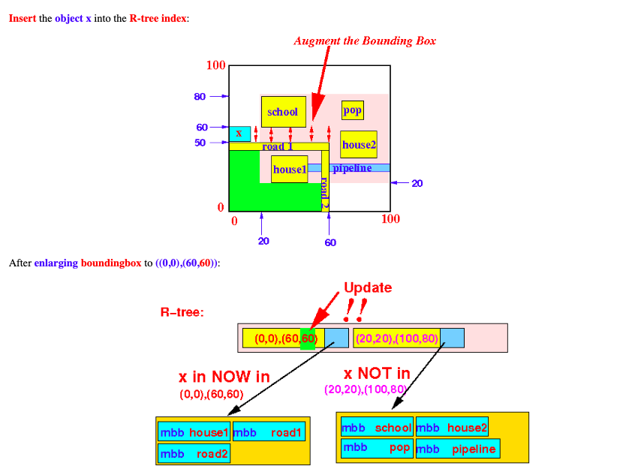
Insert Algorithm in R-tree - Example 2 (enlarge BB)

Slide 25
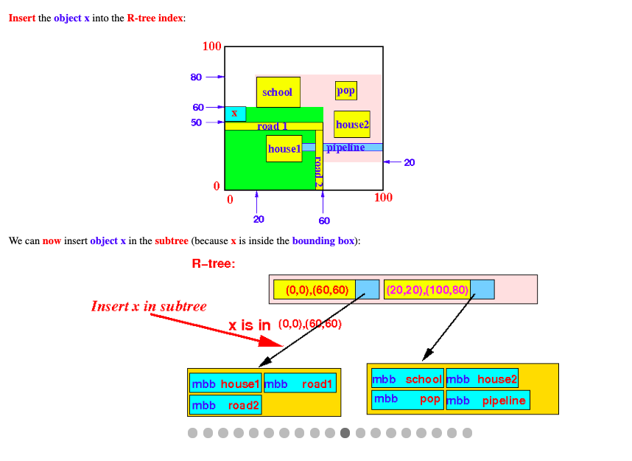
Insert Algorithm in R-tree - Example 2 (enlarge BB)

Slide 26
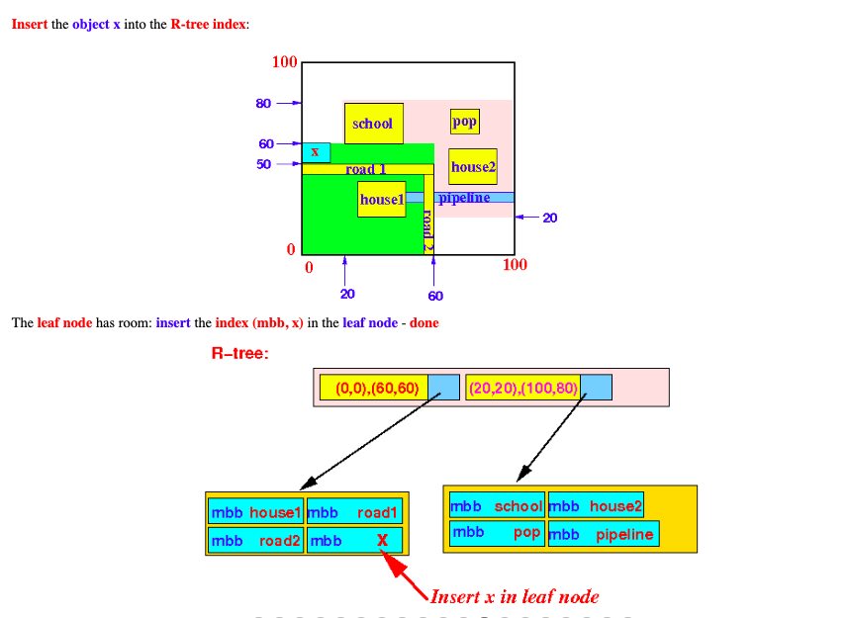
Insert Algorithm in R-tree - Example 2 (enlarge BB)

Slide 27
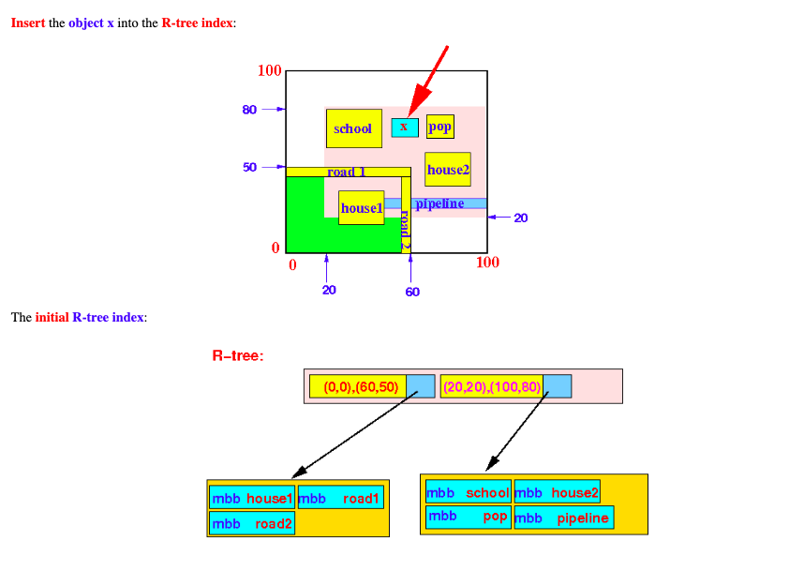
Insert Algorithm in R-tree - Example 3 (split node)

Slide 28
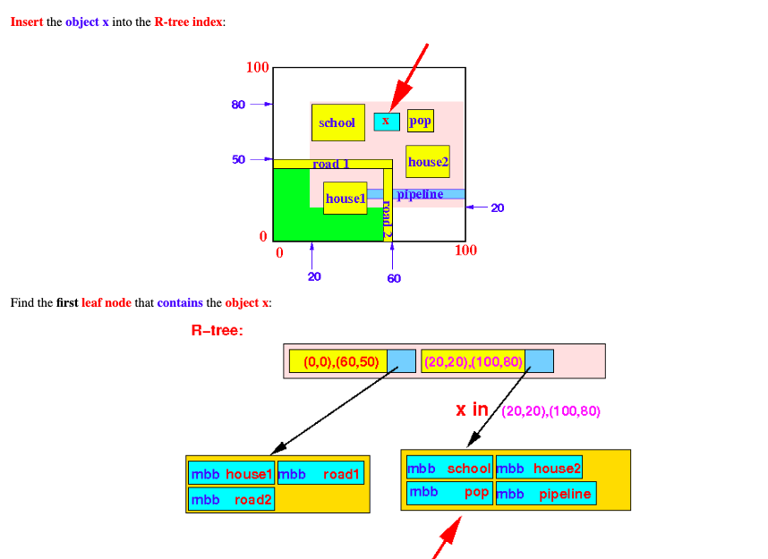
Insert Algorithm in R-tree - Example 3 (split node)

Slide 29
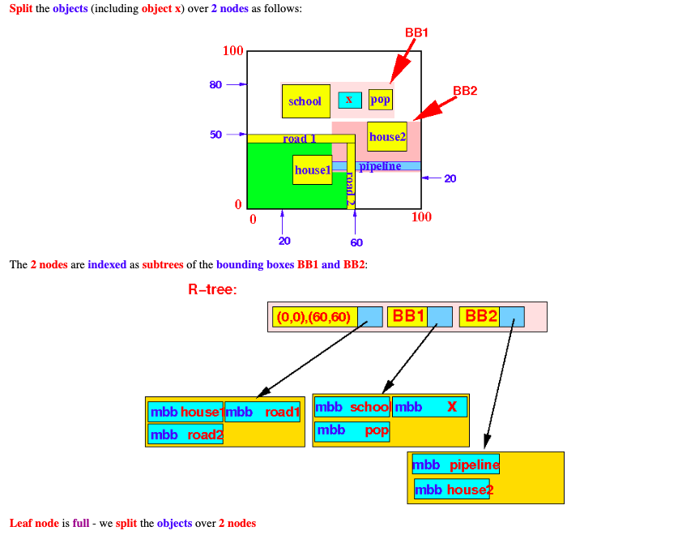
Insert Algorithm in R-tree - Example 3 (split node)

Slide 30
R-Tree – Splitting
A full node contains M entries. Divide the collection of M+1 entries between 2 nodes.
Objective: Make it as unlikely as possible for the resulting two new nodes to be
lose overlap
Minimize search time
hint: The total area of two covering rectangles after a split should be minimized.
Ways to find the minimum area node split?
Exhaustive algorithm,
Quadratic-cost algorithm,
Linear cost algorithm.
Bad Split
Area is large
Good Split

Slide 31
R-Tree – Splitting
Exhaustive Algorithm
Generate all possible groups and choose the best with minimum area.
Number of possibilities ~ 2 to power of M-1
M ~ 50 → Number of possibilities ~ 600 Trillion
The best algorithm is to find split but it is not used because it needs to find and experiment with all methods and this needs time

Slide 32
R-Tree – Splitting
Quadratic-Cost algorithm
Quadratic split divides the entries in a node into two new nodes as follows
Find pair of entries with “maximum separation”
that is, the pair such that the bounding box of the two would has the maximum wasted space (area of bounding box – sum of areas of two entries)
Place these entries in two new nodes
Repeatedly find the entry with “maximum preference” for one of the two new nodes, and assign the entry to that node
Preference of an entry to a node is the increase in area of bounding box if the entry is added to the other node
Stop when half the entries have been added to one node
Then assign remaining entries to the other node
This method takes quadratic time. O(n²)

Slide 33
R-Tree – Splitting
Linear Cost Algorithm:
Find the two bounding boxes with the greatest normalized separation along both axes, and split along this axis.
The remaining bounding boxes in the node are assigned to the nodes whose covering bounding box is increased the least by the addition node.
This method takes linear time.

Slide 34
Insert Algorithm in R-tree - Example 3 (split node)
Find the two bounding boxes with the greatest normalized separation along both axes, and split along this axis.
The remaining bounding boxes in the node are assigned to the nodes whose covering bounding box is increased the least by the addition node.
This method takes linear time.

Slide 35
Deletion
Also similar to B+-trees
Search for Node to Remove
If node with the removed entry has too few entries, reallocate them
Recursively check the parent nodes until reaching the root
Update all MBR and remove all nodes that underfull
Reinsert all entries removed from the removed nodes according to the INSERT algorithm
As always, deletion tends to be rarer than insertion for many real world databases.
Complexity
2 * N * T
N = number of entries in each node
T = tree height

Slide 36
Searching
Similar to B-tree search
Searching algorithm :find all index records whose rectangles overlap a search rectangle s , in r-tree with root node T
Search (T: Root of the R-tree, S: Search Rectangle)
[Search subtrees] If T is not a leaf, check each entry E to determine whether EI overlaps S. For all overlapping entries, invoke Search(Ep, S).
[Search leaf node ] If T is a leaf, check all entries E to determine whether EI overlaps S. If so, E is a qualifying record.
Search Complexity
Worst Case
If have overlaps , Linear Search o(n)
Best Case
No overlaps ,O(logM n)

Slide 37
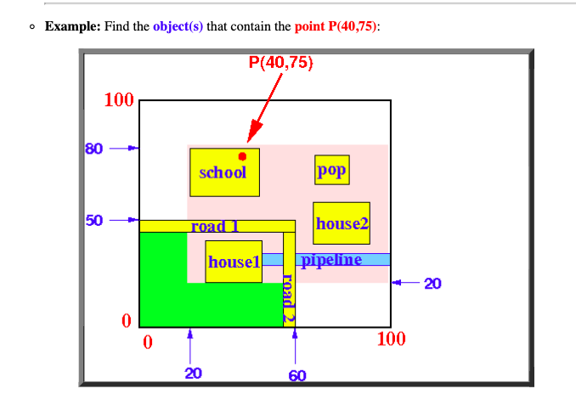
Searching

Slide 38
Searching

Slide 39
Searching
NEAREST NEIGHBOR QUERY
Two Options
Branch-and-bound search
Best first search
Branch-and-bound
Find two distances to each object
Minimum distance from the search point to any side of the other object’s MBR
Minmax distance Least of the furthest distance in every dimension
Lowest upper bound on the distance from the point to an object
Best First Search
Calculates minmax distance for all objects
R-Tree sorted by minmax distance
Removes nodes from sorted tree
If node has no children it is the nearest neighbor

Slide 40
MULTIDIMENSIONAL RANGE QUERIES
MULTIDIMENSIONAL RANGE QUERIES
If the current node is not a leaf, check all the children with an MBR that overlap the range.
For all entries that overlap, search all children nodes
If a node is a child, check all entries and any that overlap are a match
Worst Case
Linear Search
Every MBR overlaps the search area
Best Case
No more than one overlap at each level
O(log_{m} n)  Again, dependent on geometries

Slide 41
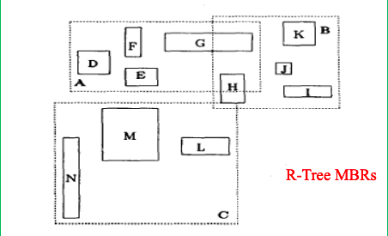
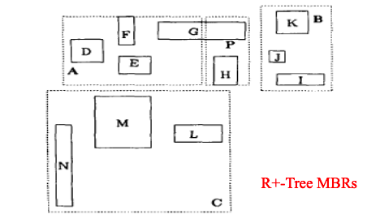
R-TREE VARIATIONS
R+-TREE
R+ trees differ from R trees in that:
No overlapping
An object ID may be stored in more than one leaf node.
Advantages
Search is easier.
A fewer nodes are visited than with the R-tree.
Disadvantages
Since rectangles are duplicated, it is larger than R tree.
Construction & maintenance is more complex.

Slide 42
R-TREE VARIATIONS
R*-TREE
R* trees differ from R trees in that:
Do not split nodes on insert
Take entries from the overfull node and reinsert them into the tree
Changes MBRs
Advantages
minimization of area covered by each MBR
minimization of overlap between MBR
Disadvantages
maximization of storage utilization

Slide 43
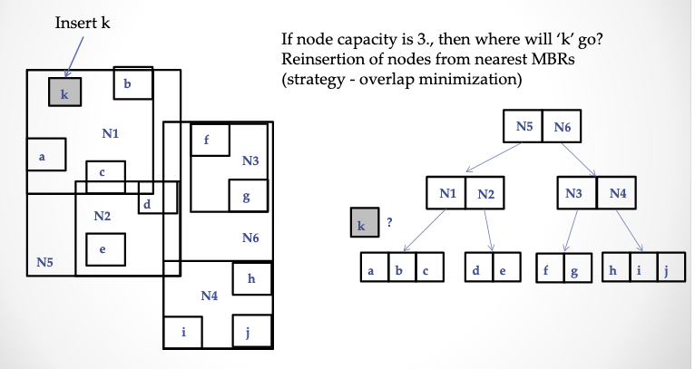
R*-TREE EXAMPLE

Slide 44
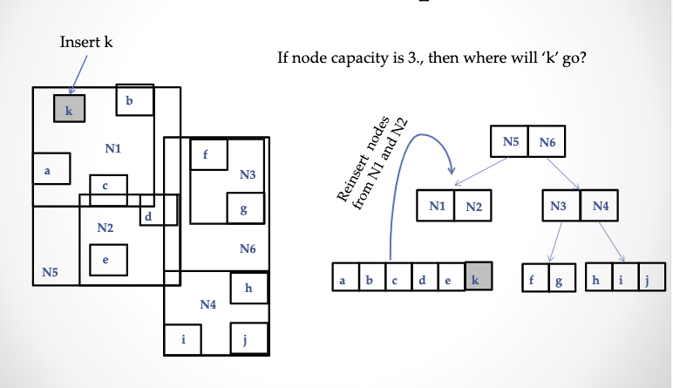
R*-TREE EXAMPLE

Slide 45
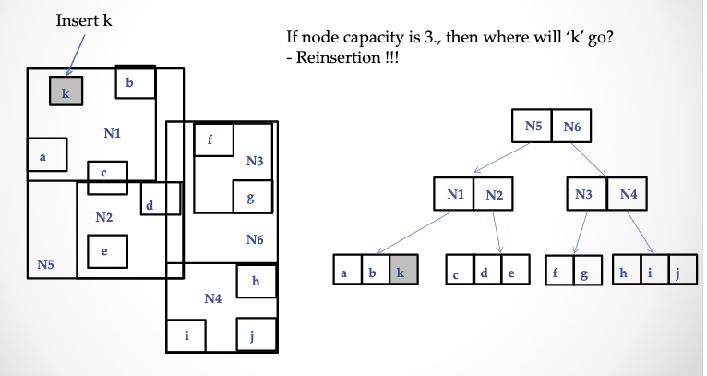
R*-TREE EXAMPLE

Slide 46
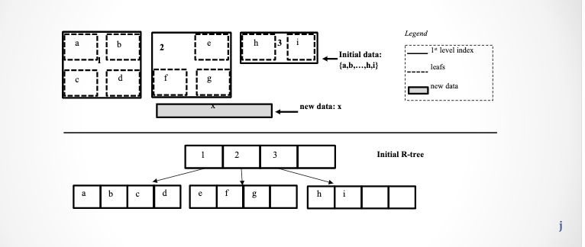
R-TREE vs R+-TREE vs R*-TREE

Slide 47
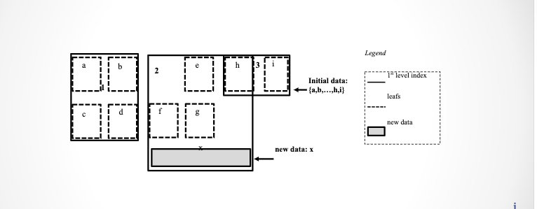
R-TREE vs R+-TREE vs R*-TREE
R-TREE

Slide 48
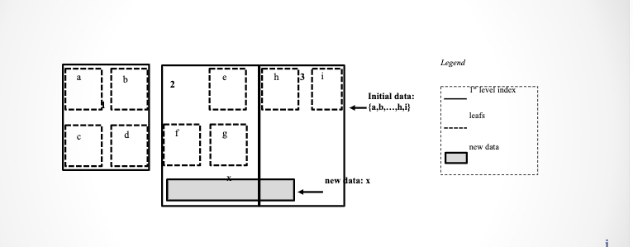
R-TREE vs R+-TREE vs R*-TREE
R+-TREE

Slide 49
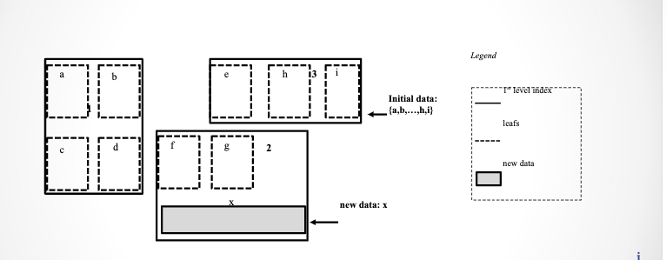
R-TREE vs R+-TREE vs R*-TREE
R*-TREE

Slide 50
R-tree size
The height of a tree with branching factor m is no more than:
h(max) = [logm #of leaf] where,
h= Maximum value for R-Tree height
because the branching factor of each node is at least m.
tree leaf node contains keys and a block pointer pointing to next leaf node
N*key size+N*(block pointer size)
Non-leaf nodes contains only keys and child pointer
(N-1)*key size+n*size of child pointer

Slide 51
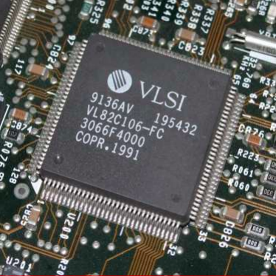
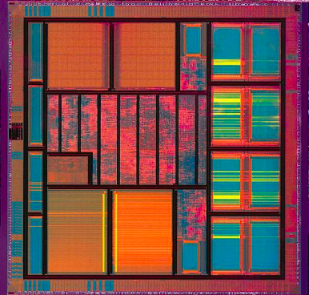
Application of R-Tree
VLSI DESIGN
The initial application that motivated Guttman to his pioneering research was VLSI design (i.e., how to efficiently answer whether a space is already covered by a chip or not).

Slide 52
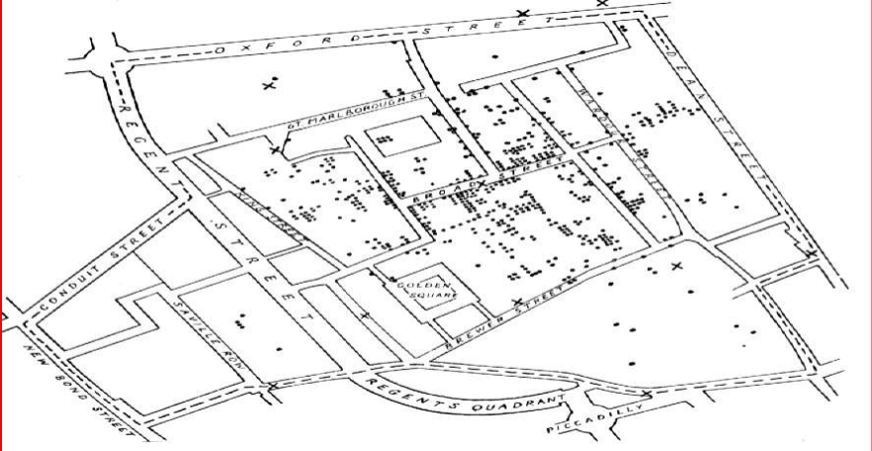
Application of R-Tree
Road Map
A common example of spatial data can be seen in a road map. Spatial data lets you use R-tree indexing .A road map is a two-dimensional object that contains points, lines, and polygons that can represent cities, roads, and political boundaries such as states or provinces.

Slide 53

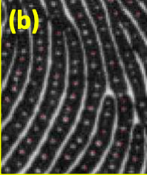
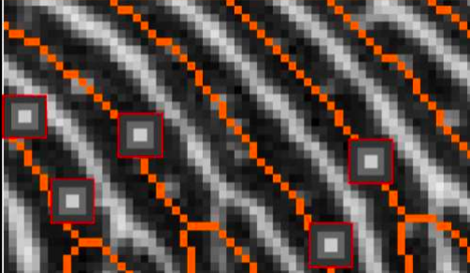
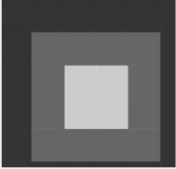
Application of R-Tree
image replica detection
The system extracts robust features from images. These features are used for indexing the images in a database using an R-tree. When a query is made about whether a test image is a replica of an image in the database, then the R-tree is traversed.
Fingerprint image (a) where pores can be easily noticed as small “holes” along ridges flow (as evident in the zoom (b)).

Slide 54
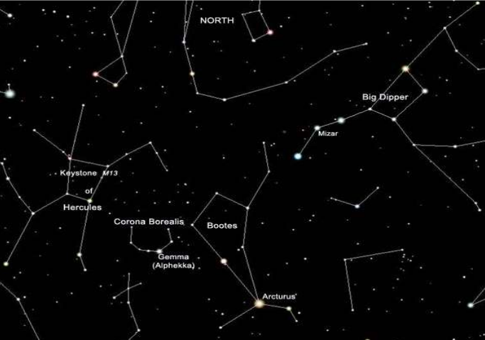
Application of R-Tree
Astronomical Data Indexing
In astronomical data collections, there are many data that can be thought of as points in a multi-dimensional space and are then suitable to be indexed using Rtrees .Coordinates on the sky can be (and often are) represented in a database as ordered couples of longitude and latitud

Slide 55
References
Course book : database management system raghu ramakrishnan 2rd edition
Wikipedia:https://en.wikipedia.org/wiki/R-tree#Search
https://www.sciencedirect.com/science/article/pii/S0022000002000351
https://www.slideshare.net/mahesamrin/rtrees-data-structure?from_action=save
https://www.slideshare.net/shakil0304003/b-tree-rtree
https://www.ibm.com/support/knowledgecenter/SSGU8G_11.50.0/com.ibm.rtree.doc/sii-overview-37788.htm#sii-overview-37788
http://www.mathcs.emory.edu/~cheung/Courses/554/Syllabus/3-index/R-tree.html
https://www.powershow.com/view/1dc6eb-MmQ5Y/RTREES__A_DYNAMIC_INDEX_STRUCTURE_FOR_SPATIAL_SEARCHING_powerpoint_ppt_presentation
https://www.powershow.com/viewfl/260135-ZDc1Z/RTree_Example_powerpoint_ppt_presentation

Slide 56
References
R-Trees: Theory and Applications
Yannis Manolopoulos‏، Alexandros Nanopoulos‏، Apostolos N. Papadopoulos‏، Yannis Theodoridis‏: https://books.google.ps/books?id=1mu099DN9UwC&pg=PA4&lpg=PA4&dq=r+tree+application&source=bl&ots=pABQGDm5tb&sig=ACfU3U0NqbfH84qct7G5iwdisGLvprzdJg&hl=ar&sa=X&ved=2ahUKEwjHjs6K-4XoAhXUi1wKHRx1AlQQ6AEwCHoECAoQAQ#v=onepage&q=r%20tree%20application&f=false
https://www2.cs.sfu.ca/CourseCentral/454/jpei/slides/R-Tree.pdf
http://www.cpe.eng.cmu.ac.th/wp-content/uploads/R-Tree.pdf
https://www.researchgate.net/publication/260599600_Corner-based_splitting_An_improved_node_splitting_algorithm_for_R-tree#pf3
https://www.researchgate.net/profile/Azzam_Sleit
https://www.u-cursos.cl/usuario/a735117f257858200f6460e7d8673d7b/mi_blog/r/rtrees.pdf
http://donar.umiacs.umd.edu/quadtree/docs/rtree_split_rules.html
http://jsi.sourceforge.net/javadoc/1.0b1/com/infomatiq/jsi/rtree/RTree.html
https://slideplayer.com/slide/5025537/
https://slideplayer.com/slide/8278697/

Slide 57
References
https://slideplayer.com/slide/6133279/
https://slideplayer.com/slide/9773091/
http://www.postgis.org/files/OSDB2_PostGIS_Presentation.pdf
https://postgis.net/workshops/postgis-intro/indexing.html
http://postgis.net/workshops/postgis-intro/geometries.html

Slide 58
R-Tree Index Structure
b1
c
d
a
b
R1
R
b2
g
e
R1
R2
f
R1
R2
R
b1
b2
b3
b4
h
b3
b1
b1
b3
b4
R2
i
a
b
c
d
e
g
f
h
i
j
k
l
b4
k
l
j

Slide 59
Thank You

